Slide 1
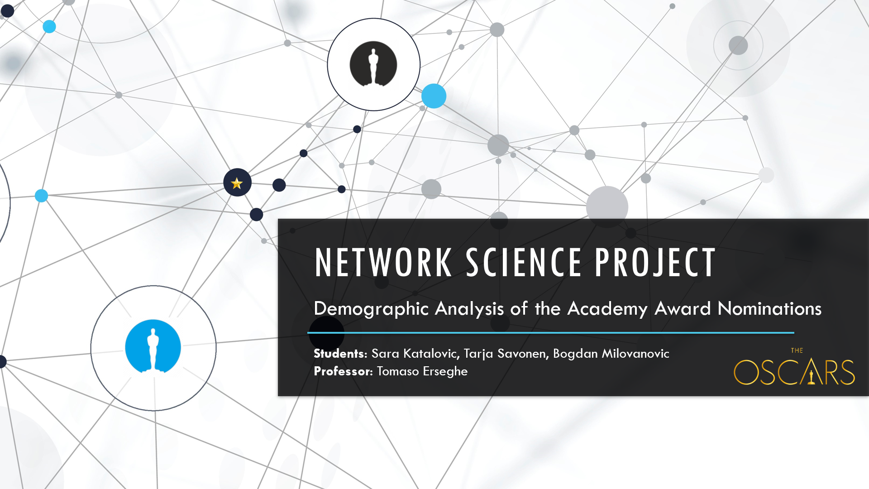

Slide 2
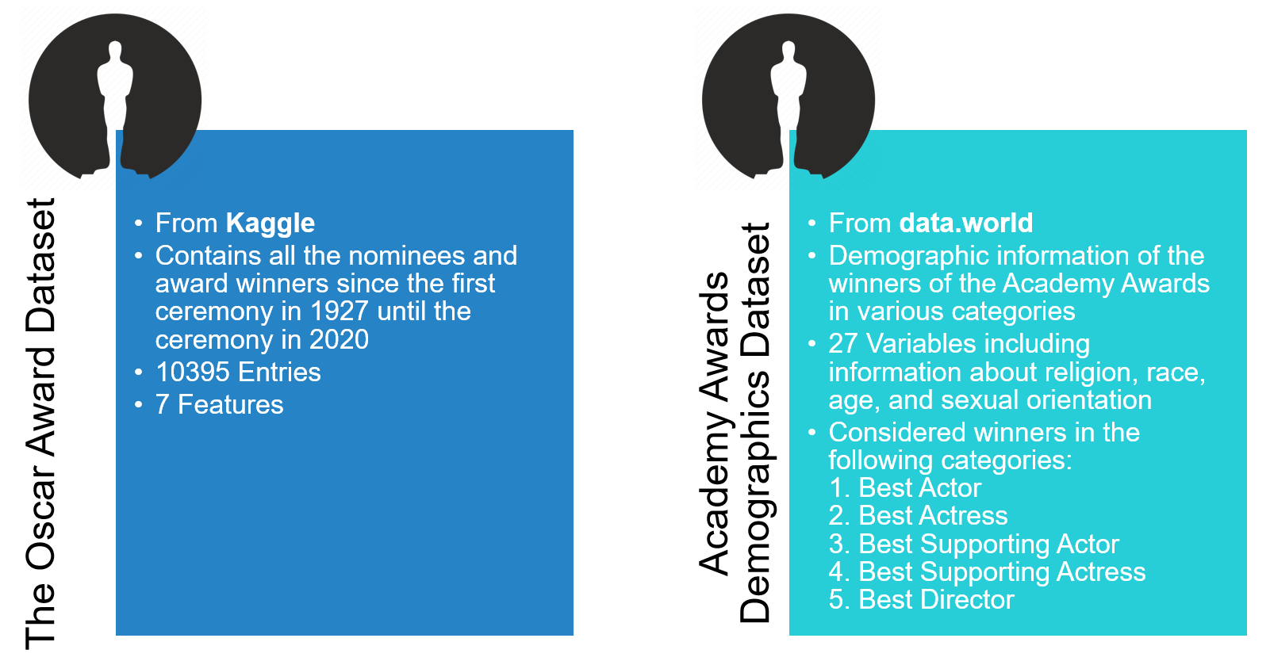
Datasets & Preprocessing
Finally, we were left with 1092
unique values and 3 chosen features
Finally, we were left with 441 unique values and 5 chosen categories

Slide 3
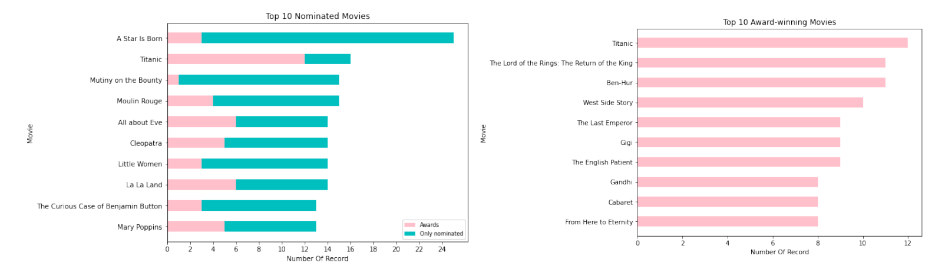
The Oscar Award Dataset - Movies
Top Nominations & Winners
Top Award Winners

Slide 4
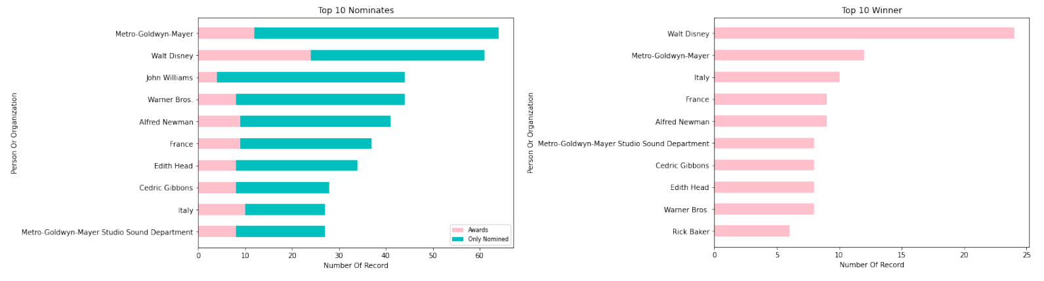
The Oscar Award Dataset - Person/Organization
Top Nominations & Winners
Top Award Winners

Slide 5
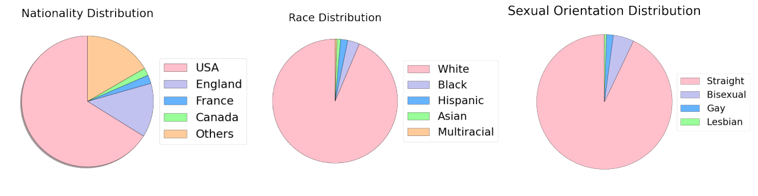
Academy Awards Demographics Dataset

Slide 6
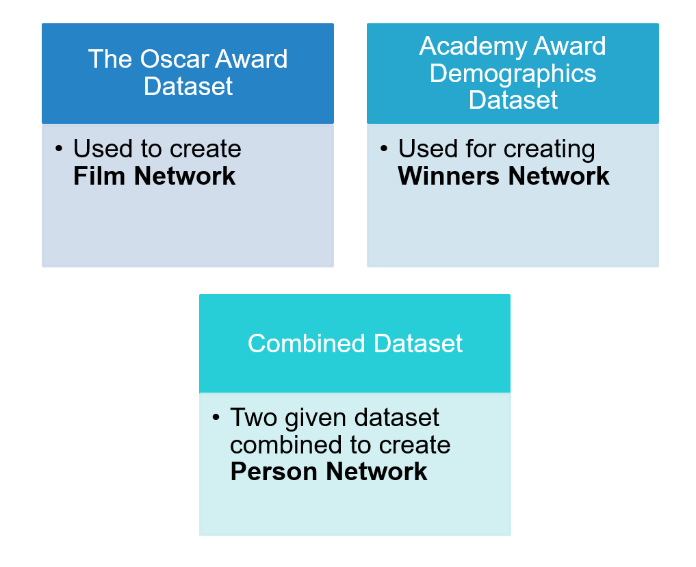
Networks

Slide 7
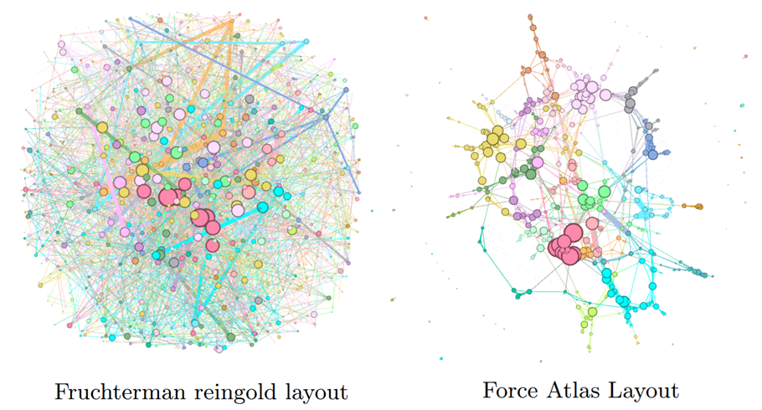
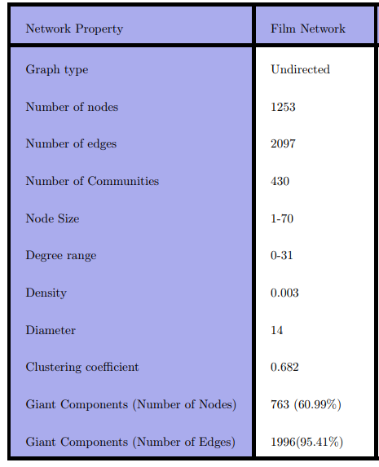
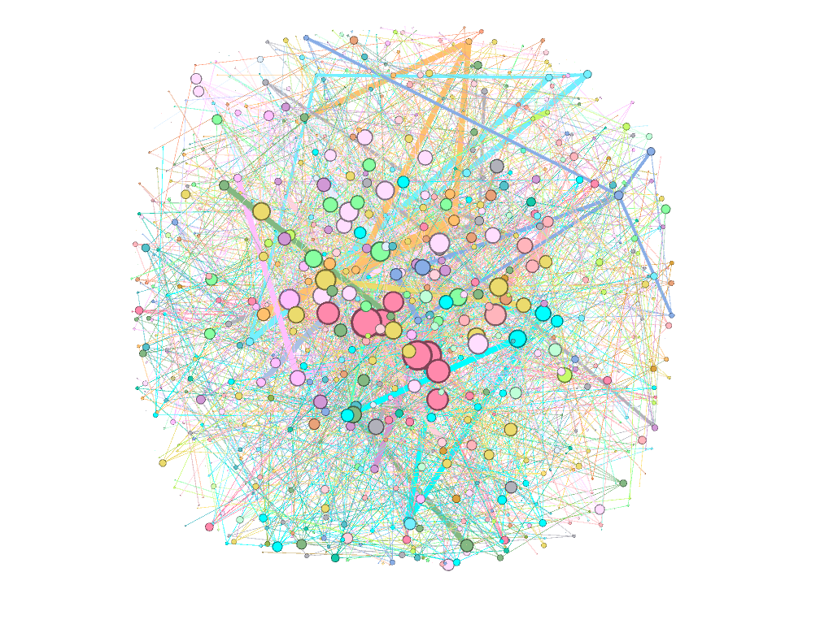
FILM NETWORK

Slide 8
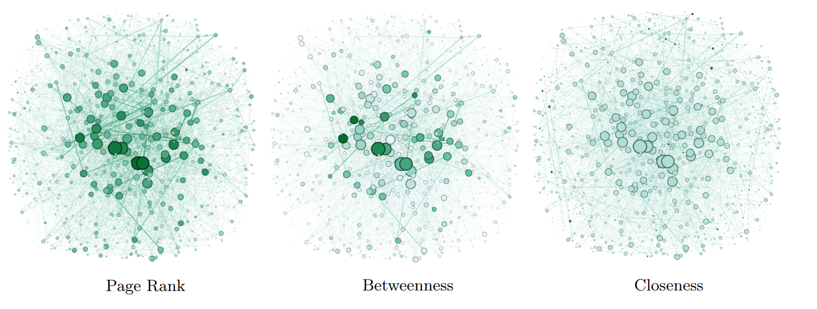
FILM NETWORK

Slide 9
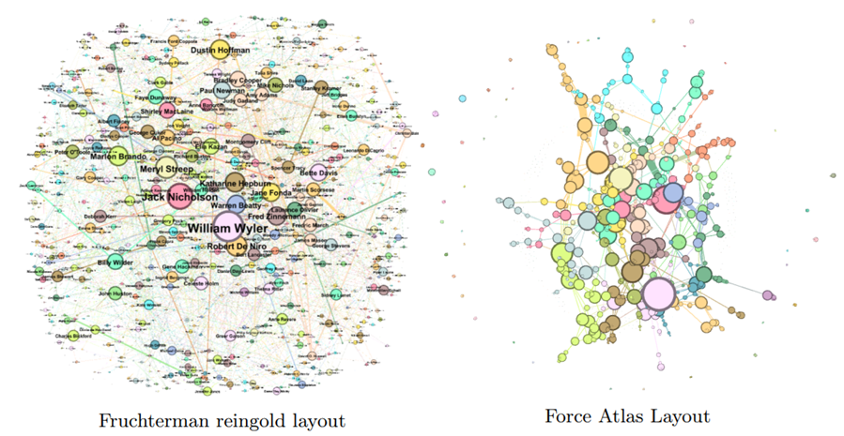
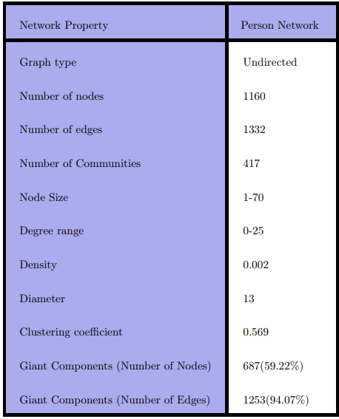
PERSON NETWORK

Slide 10
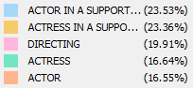
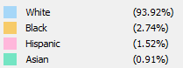
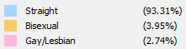
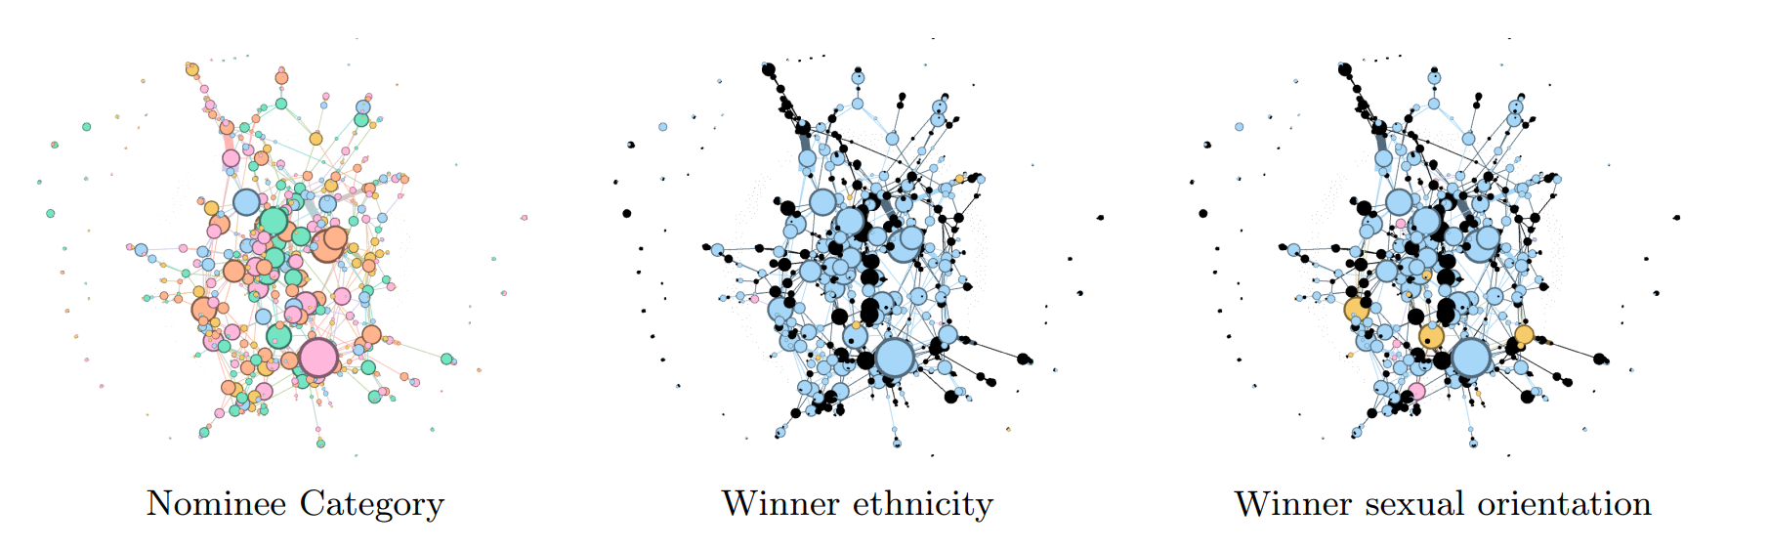
PERSON NETWORK

Slide 11
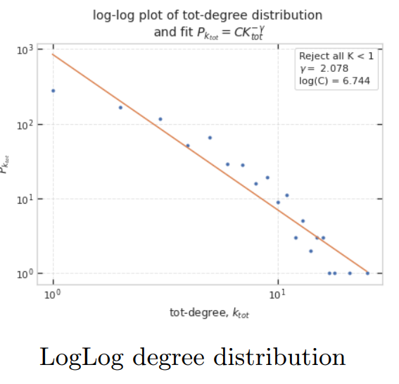
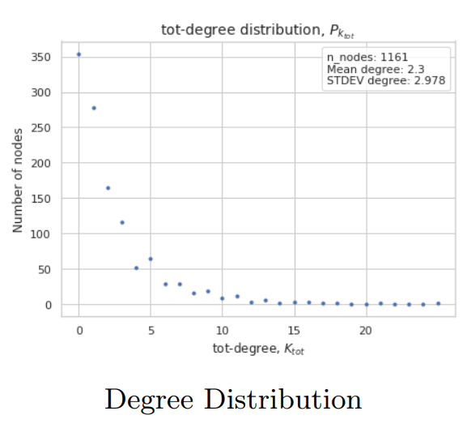
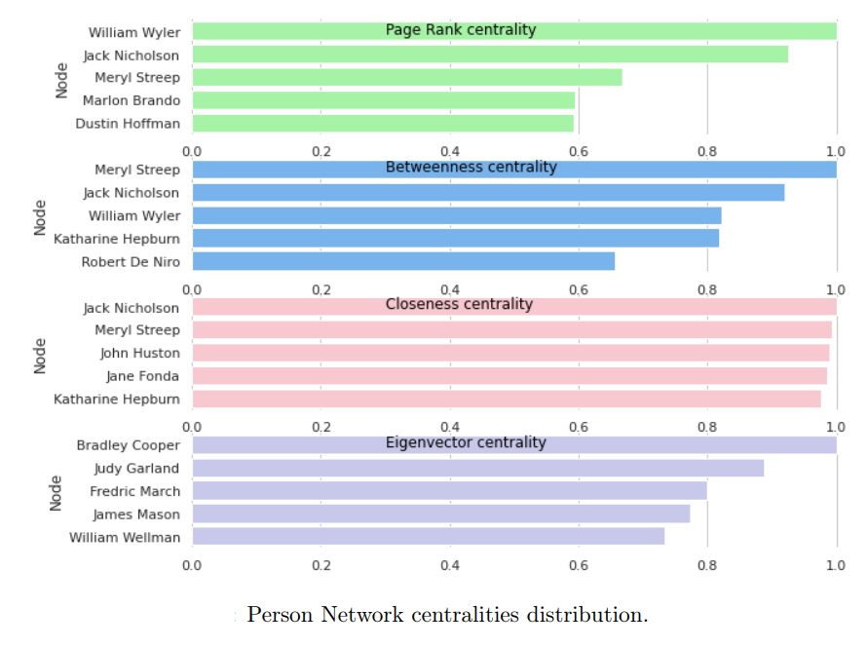
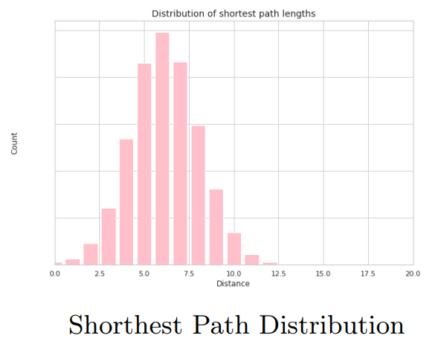
PERSON NETWORK

Slide 12
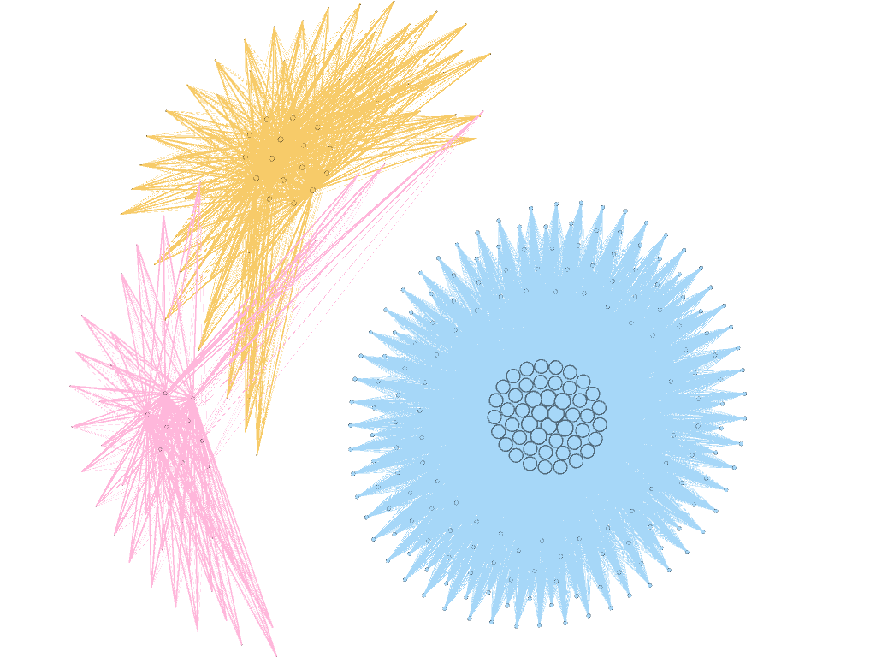
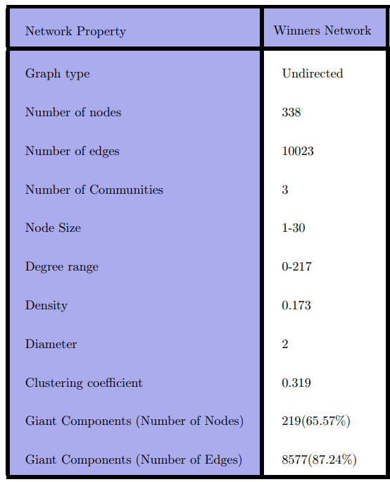
Winners Network

Slide 13
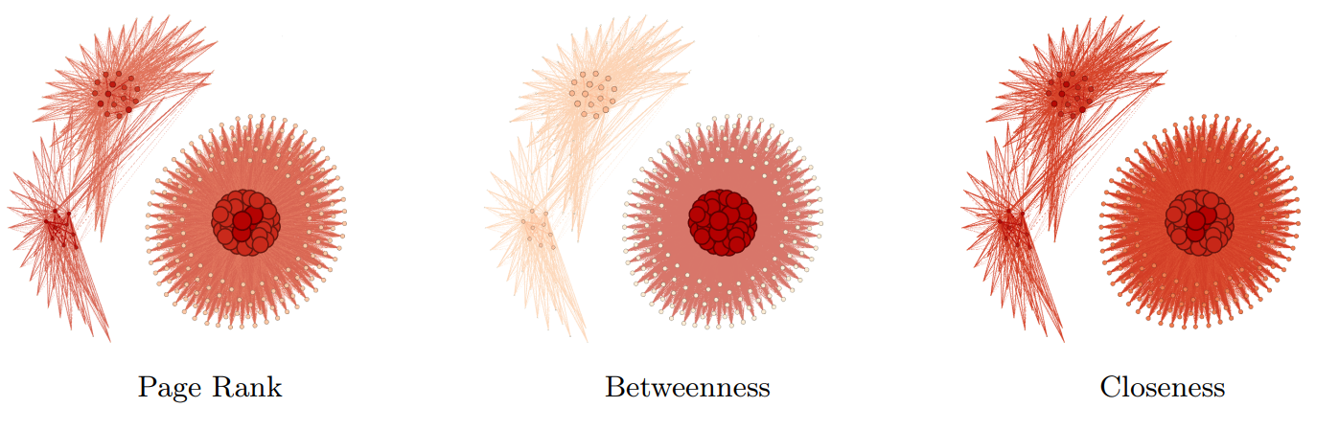
Winners Network- Centralities

Slide 14
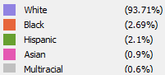
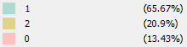
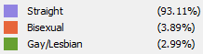
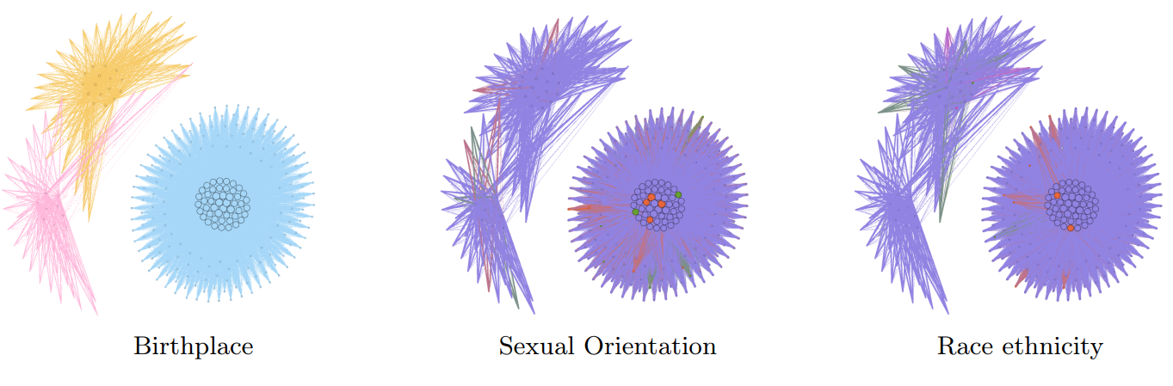
Winners Network- Attributes

Slide 15
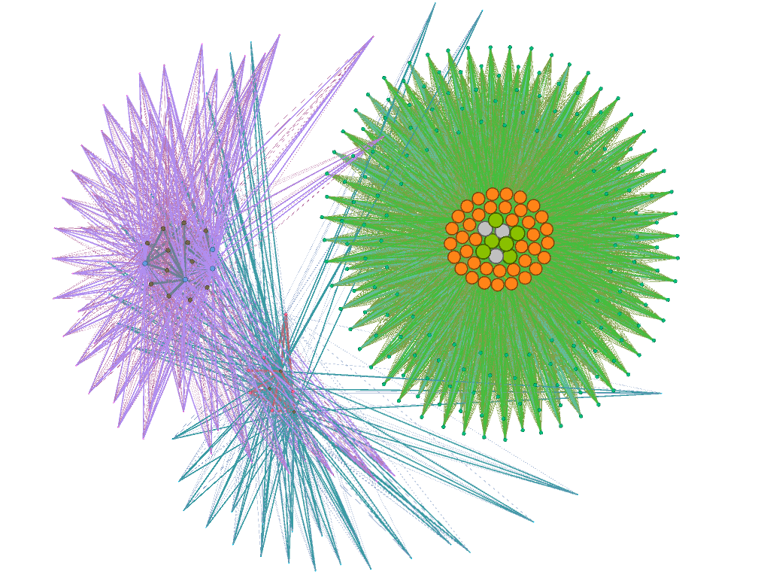
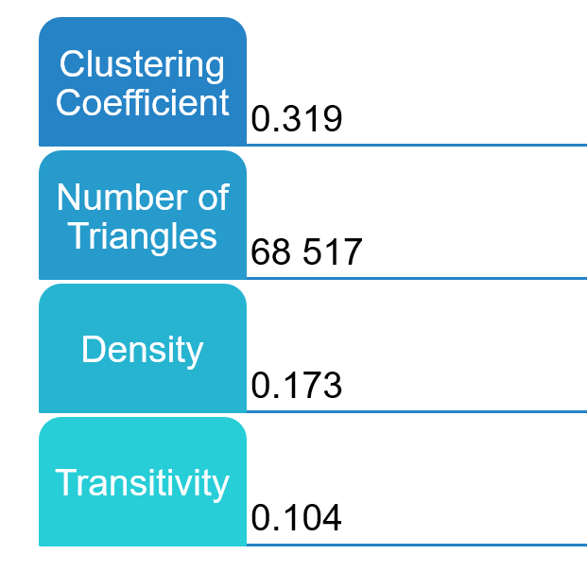
Winners Network- Transitivity

Slide 16
Conclusion
Three different networks were created using 2 different datasets.
The communities in the graphs were classified based on different categories and attributes.
Given that our three Film, Person, and Winner networks have 0.003, 0.002, and 0.173 densities respectively, it indicates that there is low number of edges.
All three networks are not connected because each one of them have more than one component.
The person network is scaled-free, since the it follows a power law and the parameter γ is in the range 2 < γ < 3.
The Film and Person network have small closeness centrality values, while Winner's network has very high closeness values.
All three network show similar behavior when it comes to page rank and betweenness centralities.

Slide 17
